Slide 2
Topics
  Introduction
  Dialog Boxes
  Creating Windows
  Layout Managers
  Radio Buttons and Check Boxes
  Borders
  Focus on Problem Solving: Extending the JPanel class
  Splash Screens
  Using Console Output to Debug a GUI Application

Slide 3

Introduction
Many Java application use a graphical user interface or GUI (pronounced “gooey”).
A GUI is a graphical window or windows that provide interaction with the user.
GUI’s accept input from:
  the keyboard
  a mouse.
A window in a GUI consists of components that:
  present data to the user
  allow interaction with the application.

Slide 4
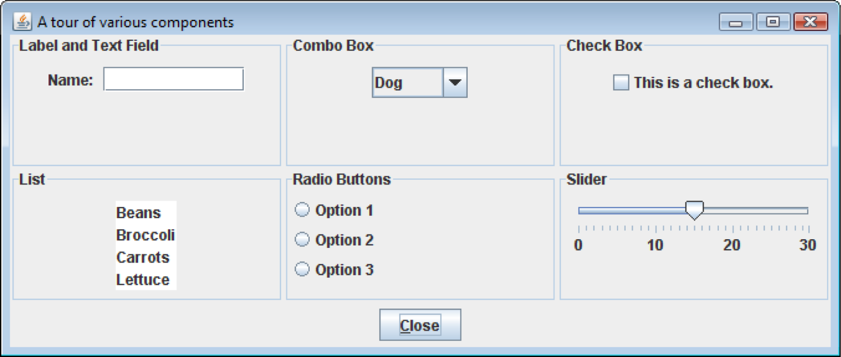
Introduction
Some common GUI components are:
  buttons, labels, text fields, check boxes, radio buttons, combo boxes, and sliders.

Slide 5
JFC, AWT, Swing
Java programmers use the Java Foundation Classes (JFC) to create GUI applications.
The JFC consists of several sets of classes, many of which are beyond the scope of this book.
The two sets of JFC classes that we focus on are AWT and Swing classes.
Java is equipped with a set of classes for drawing graphics and creating graphical user interfaces.
These classes are part of the Abstract Windowing Toolkit (AWT).

Slide 6
JFC, AWT, Swing
The AWT:
  allows creation of applications and applets with GUI components.
  does not actually draw user interface components on the screen.
  communicates with a layer of software, peer classes.
Each version of Java for a particular operating system has its own set of peer classes.

Slide 7
JFC, AWT, Swing
Java programs using the AWT:
  look consistent with other applications on the same system.
  can offer only components that are common to all the operating systems that support Java.
The behavior of components across various operating systems can differ.
Programmers cannot easily extend the AWT components.
AWT components are commonly called heavyweight components.

Slide 8
JFC, AWT, Swing
Swing was introduced with the release of Java 2.
Swing is a library of classes that provide an improved alternative for creating GUI applications and applets.
Very few Swing classes rely on peer classes, so they are referred to called lightweight components.
Swing draws most of its own components.
Swing components have a consistent look and predictable behavior on any operating system.
Swing components can be easily extended.

Slide 9
javax.swing and java.awt
In an application that uses Swing classes, it is necessary to use the following statement:
import javax.swing.*;
  Note the letter x that appears after the word java.
Some of the AWT classes are used to determine when events, such as the clicking of a mouse, take place in applications.
In an application that uses an AWT class, it is necessary to use the following statement.
import java.awt.*;
Note that there is no x after java in this package name.

Slide 10
Event Driven Programming
Programs that operate in a GUI environment must be event-driven.
An event is an action that takes place within a program, such as the clicking of a button.
Part of writing a GUI application is creating event listeners.
An event listener is an object that automatically executes one of its methods when a specific event occurs.

Slide 11
Dialog Boxes
A dialog box is a small graphical window that displays a message to the user or requests input.
A variety of dialog boxes can be displayed using the JOptionPane class.
  Message Dialog - a dialog box that displays a message.
  Input Dialog - a dialog box that prompts the user for input.
  Confirm Dialog This is a dialog box that asks the user a Yes/No question.

Slide 12
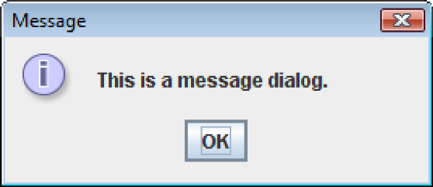
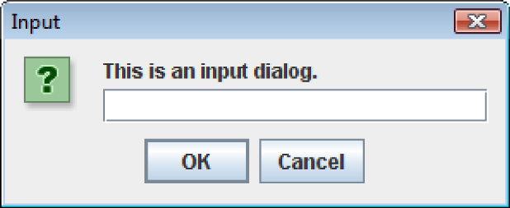
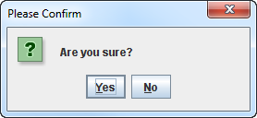
Dialog Boxes
The JOptionPane class provides static methods to display each type of dialog box.

Slide 13
Message Dialogs
JOptionPane.showMessageDialog method is used to display a message dialog.
There are several overloaded versions of this method.
  showMessageDialog(Component parent,
  Object message)
  showMessageDialog(Component parent,
  Object message,
  String title,
  int messageType)

Slide 14
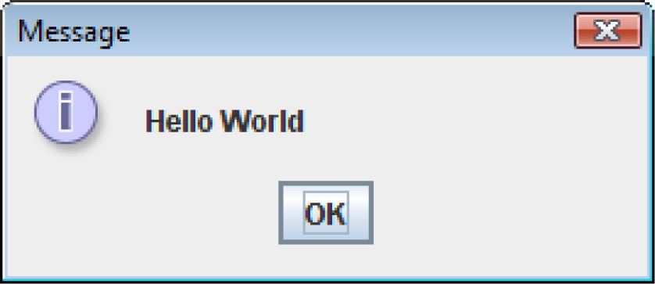
Message Dialogs
  JOptionPane.showMessageDialog(null, "Hello World");
The first argument can be a reference to a graphical component.
  The dialog box is displayed inside that component.
  If null is passed as the first argument, which causes the dialog box to be displayed in the center of the screen.
The second argument is the message that is to be displayed.

Slide 15
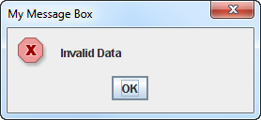
Message Dialogs
By default the dialog box has:
  the string “Message” displayed in its title bar, and
  an information icon (showing the letter “i”) is displayed.
  JOptionPane.showMessageDialog(null,
  "Invalid Data",
  "My Message Box",
  JOptionPane.ERROR_MESSAGE);
The third option is the title bar text.

Slide 16
Message Dialogs
These constants can be use to control the icon that is displayed.
  JOptionPane.ERROR_MESSAGE
  JOptionPane.INFORMATION_MESSAGE
  JOptionPane.WARNING_MESSAGE
  JOptionPane.QUESTION_MESSAGE
  JOptionPane.PLAIN_MESSAGE

Slide 17
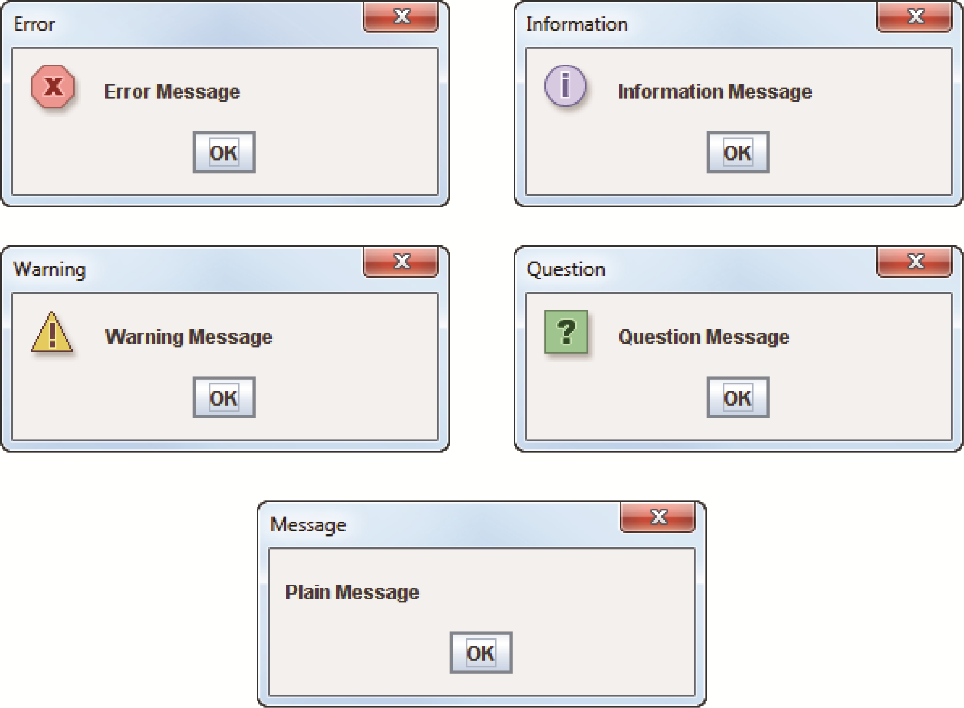
Message Dialogs

Slide 18
Message Dialogs
The dialog boxes displayed by the JOptionPane class are modal dialog boxes.
A modal dialog box suspends execution of any other statements until the dialog box is closed.
When the JOptionPane.showMessageDialog method is called, the statements that appear after the method call do not execute until the user closes the message box.

Slide 19
Input Dialogs
An input dialog is a quick and simple way to ask the user to enter data.
The dialog displays a text field, an Ok button and a Cancel button.
If Ok is pressed, the dialog returns the user’s input.
If Cancel is pressed, the dialog returns null.

Slide 20
Input Dialogs
The JOptionPane has several overloaded versions of the static showInputDialog method.
Here are two of them:
  showInputDialog(Object message)
  showInputDialog(Component parent,
  Object message,
  String title,
  int messageType)

Slide 21
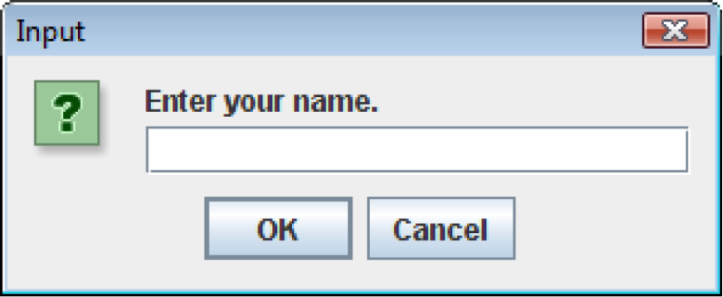
Input Dialogs
  String name;
  name = JOptionPane.showInputDialog("Enter your name.");
The argument passed to the method is the message to display.
If the user clicks on the OK button, name references the string entered by the user.
If the user clicks on the Cancel button, name references null.

Slide 22
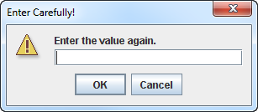
Input Dialogs
By default the input dialog box:
  has the string “Input” in its title bar, and
  displays a question icon.
  String value;
  value = JOptionPane.showInputDialog(null,
  "Enter the value again.",
  "Enter Carefully!",
  JOptionPane.WARNING_MESSAGE);

Slide 23
Confirm Dialog
A confirm dialog box typically asks the user a yes or no question.
By default Yes, No, and Cancel buttons are displayed.
The showConfirmDialog method is used to display a confirm dialog box.
There are several overloaded versions of this method.
  int showConfirmDialog(Component parent,
  Object message)
  int showConfirmDialog(Component parent,
  Object message,
  String title,
  int optionType)

Slide 24
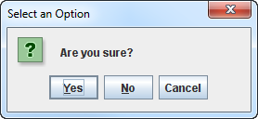
Confirm Dialog
  int value;
  value = JOptionPane.showConfirmDialog(null,
  "Are you sure?");
By default the confirm dialog box displays:
  “Select an Option” in its title bar,
  Yes, No, and Cancel buttons.

Slide 25
Confirm Dialog
The showConfirmDialog method returns an integer that represents the button clicked by the user.
The button that was clicked is determined by comparing the method’s return value to one of the following constants:
  JOptionPane.YES_OPTION
  JOptionPane.NO_OPTION
  JOptionPane.CANCEL_OPTION

Slide 26
Confirm Dialog
int value;
value = JOptionPane.showConfirmDialog(null,
"Are you sure?");
if (value == JOptionPane.YES_OPTION){
//If the user clicked Yes, this code is executed.
}
else if (value == JOptionPane.NO_OPTION){
//If the user clicked no, this code is executed.
}
else if (value == JOptionPane.CANCEL_OPTION){
//If the user clicked Cancel, this code is executed.
}

Slide 27
Confirm Dialog
  int value;
  value = JOptionPane.showConfirmDialog(null,
  "Are you sure?",
  "Please Confirm", JOptionPane.YES_NO_OPTION);
One of the following constants can be used for the fourth parameter:
  JOptionPane.YES_NO_OPTION
  JOptionPane.YES_NO_CANCEL_OPTION
Example:
TestAverageDialog.java

Slide 28
Stopping a GUI Program
A GUI program does not automatically stop executing when the end of the main method is reached.
Swing generates a thread, which is a task running in the JVM.
If the System.exit method is not called, this thread continues to execute.

Slide 29
Stopping a GUI Program
The System.exit method requires an integer argument.
  System.exit(0);
This argument is an exit code that is passed back to the operating system.
This code is usually ignored, however, it can be used outside the program:
  to indicate whether the program ended successfully or as the result of a failure.
  The value 0 traditionally indicates that the program ended successfully.

Slide 30
Creating Windows
Often, applications need one or more windows with various components.
A window is a container, which is simply a component that holds other components.
A container that can be displayed as a window is a frame.
In a Swing application, you create a frame from the JFrame class.

Slide 31
Creating Windows
A frame is a basic window that has:
  a border around it,
  a title bar, and
  a set of buttons for:
    minimizing,
    maximizing, and
    closing the window.
These standard features are sometimes referred to as window decorations.

Slide 32
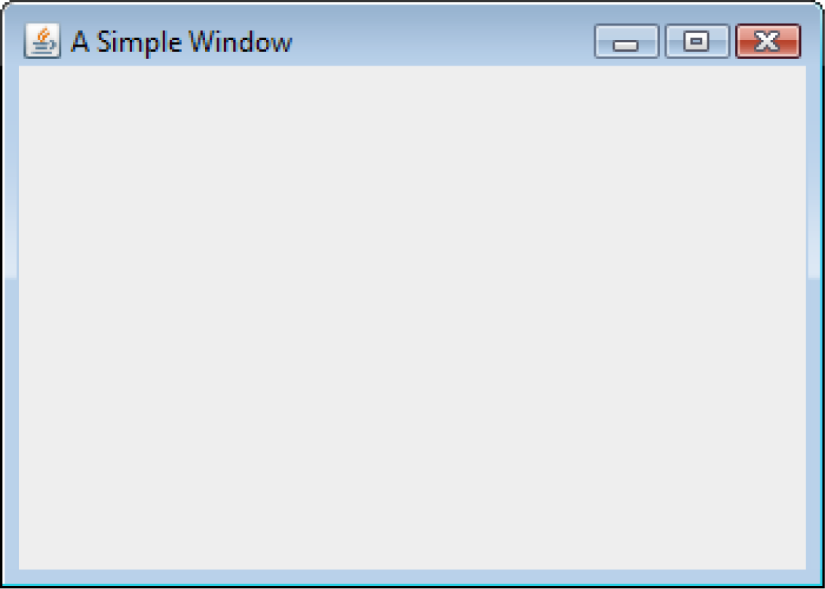
Creating Windows
See example: SimpleWindow.java

Slide 33
Creating Windows
The following import statement is needed to use the swing components:
  import javax.swing.*;
In the main method, two constants are declared:
  final int WINDOW_WIDTH = 350,
  WINDOW_HEIGHT = 250;
We use these constants later in the program to set the size of the window.
The window’s size is measured in pixels.
A pixel (picture element) is one of the small dots that make up a screen display.

Slide 34
Creating Windows
An instance of the JFrame class needs to be created:
  JFrame window = new JFrame("A Simple Window");
This statement:
  creates a JFrame object in memory and
  assigns its address to the window variable.
The string that is passed to the constructor will appear in the window’s title bar when it is displayed.
A JFrame is initially invisible.

Slide 35
Creating Windows
To set the size of the window:
  window.setSize(WINDOW_WIDTH, WINDOW_HEIGHT);
To specify the action to take place when the user clicks on the close button.
window.setDefaultCloseOperation(JFrame.EXIT_ON_CLOSE);
The setDefaultCloseOperation method takes an int argument which specifies the action.
  JFrame.HIDE_ON_CLOSE - causes the window to be hidden from view, but the application does not end.
  The default action is JFrame.HIDE_ON_CLOSE.

Slide 36
Creating Windows
The following code displays the window:
  window.setVisible(true);
The setVisible method takes a boolean argument.
  true - display the window.
  false - hide the window.

Slide 37
Extending JFrame
We usually use inheritance to create a new class that extends the JFrame class.
When a new class extends an existing class, it inherits many of the existing class’s members just as if they were part of the new class.
These members act just as if they were written into the new class declaration.
New fields and methods can be declared in the new class declaration.
This allows specialized methods and fields to be added to your window.
Examples: SimpleWindow2.java, SimpleWindow2Demo.java

Slide 38
Adding Components
Swing provides numerous components that can be added to a window.
Three fundamental components are:
  JLabel : An area that can display text.
  JTextField : An area in which the user may type a
  single line of input from the keyboard.
  JButton : A button that can cause an action to
  occur when it is clicked.

Slide 39
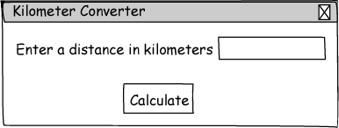
Sketch of Kilometer Converter Graphical User Interface
Text Field
Window Title
Label
Button

Slide 40
Adding Components
  private JLabel messageLabel;
  private JTextField kiloTextField;
  private JButton calcButton;
  …
  messageLabel = new JLabel(
  "Enter a distance in kilometers");
  kiloTextField = new JTextField(10);
  calcButton = new JButton("Calculate");
This code declares and instantiates three Swing components.

Slide 41
Adding Components
A content pane is a container that is part of every JFrame object.
Every component added to a JFrame must be added to its content pane. You do this with the JFrame class's add method.
The content pane is not visible and it does not have a border.
A panel is also a container that can hold GUI components.

Slide 42
Adding Components
Panels cannot be displayed by themselves.
Panels are commonly used to hold and organize collections of related components.
Create panels with the JPanel class.
  private JPanel panel;
  …
  panel = new JPanel();
  panel.add(messageLabel);
  panel.add(kiloTextField);
  panel.add(calcButton);

Slide 43
Adding Components
Components are typically placed on a panel and then the panel is added to the JFrame's content pane.
  add(panel);
Examples: KiloConverterWindow.java, KilometerConverter.java

Slide 44
Handling Action Events
An event is an action that takes place within a program, such as the clicking of a button.
When an event takes place, the component that is responsible for the event creates an event object in memory.
The event object contains information about the event.
The component that generated the event object is know as the event source.
It is possible that the source component is connected to one or more event listeners.

Slide 45
Handling Action Events
An event listener is an object that responds to events.
The source component fires an event which is passed to a method in the event listener.
Event listener classes are specific to each application.
Event listener classes are commonly written as private inner classes in an application.

Slide 46
Writing Event Listener Classes as Private Inner Classes
A class that is defined inside of another class is known as an inner class
public class Outer
{
Fields and methods of the Outer class appear here.
private class Inner
{
Fields and methods of the Inner class appear here.
}
}

Slide 47
Event Listeners Must Implement an Interface
All event listener classes must implement an interface.
An interface is something like a class containing one or more method headers.
When you write a class that implements an interface, you are agreeing that the class will have all of the methods that are specified in the interface.

Slide 48
Handling Action Events
JButton components generate action events, which require an action listener class.
Action listener classes must meet the following requirements:
  It must implement the ActionListener interface.
  It must have a method named actionPerformed.
The actionPerformed method takes an argument of the ActionEvent type.
  public void actionPerformed(ActionEvent e)
  {
  Code to be executed when button is pressed goes here.
  }

Slide 49
Handling Action Events
Event
Object
JButton Component
Action Listener Object
void actionPerformed(ActionEvent e)
When the button is pressed …
The JButton component generates an event object and passes it to the action listener object's actionPerformed method.
Examples:
KiloConverterWindow.java, KilometerConverter.java

Slide 50
Registering A Listener
The process of connecting an event listener object to a component is called registering the event listener.
JButton components have a method named addActionListener.
  calcButton.addActionListener(new CalcButtonListener());
When the user clicks on the source button, the action listener object’s actionPerformed method will be executed.

Slide 51
Background and Foreground Colors
Many of the Swing component classes have methods named setBackground and setForeground.
setBackground is used to change the color of the component itself.
setForeground is used to change the color of the text displayed on the component.
Each method takes a color constant as an argument.

Slide 52
Color Constants
There are predefined constants that you can use for colors.
  Color.BLACK Color.BLUE
  Color.CYAN Color.DARK_GRAY
  Color.GRAY Color.GREEN
  Color.LIGHT_GRAY Color.MAGENTA
  Color.ORANGE Color.PINK
  Color.RED Color.WHITE
  Color.YELLOW
Examples: ColorWindow.java, ColorDemo.java

Slide 53
The ActionEvent Object
Event objects contain certain information about the event.
This information can be obtained by calling one of the event object’s methods.
Two of these methods are:
  getSource - returns a reference to the object that generated this event.
  getActionCommand - returns the action command for this event as a String.
Example:
  EventObjectWindow.java, EventObjectDemo.java

Slide 54
Equipping GUI Classes with a main Method
Java applications always starts execution with a method named main.
We have seen applications in two separate files, one file for the class that defines the GUI window and one file that contains the main method that creates an object of the GUI window class.
Applications can also be written with the main method directly written into the GUI class.
See example: EmbeddedMain.java

Slide 55
Layout Managers
An important part of designing a GUI application is determining the layout of the components.
The term layout refers to the positioning and sizing of components.
In Java, you do not normally specify the exact location of a component within a window.
A layout manager is an object that:
  controls the positions and sizes of components, and
  makes adjustments when necessary.

Slide 56
Layout Managers
The layout manager object and the container work together.
Java provides several layout managers:
  FlowLayout - Arranges components in rows. This is the default for panels.
  BorderLayout - Arranges components in five regions:
    North, South, East, West, and Center.
    This is the default layout manager for a JFrame object’s content pane.
  GridLayout - Arranges components in a grid with rows and columns.

Slide 57
Layout Managers
The Container class is one of the base classes that many components are derived from.
Any component that is derived from the Container class can have a layout manager added to it.
You add a layout manager to a container by calling the setLayout method.
  JPanel panel = new JPanel();
  panel.setLayout(new BorderLayout());
In a JFrame constructor you might use:
  setLayout(new FlowLayout());

Slide 58
FlowLayout Manager
FlowLayout is the default layout manager for JPanel objects.
Components appear horizontally, from left to right, in the order that they were added. When there is no more room in a row, the next components “flow” to the next row.
See example: FlowWindow.java

Slide 59
FlowLayout Manager
The FlowLayout manager allows you to align components:
  in the center of each row
  along the left or right edges of each row.
An overloaded constructor allows you to pass:
  FlowLayout.CENTER,
  FlowLayout.LEFT, or
  FlowLayout.RIGHT.
Example:
setLayout(new FlowLayout(FlowLayout.LEFT));

Slide 60
FlowLayout Manager
FlowLayout inserts a gap of five pixels between components, horizontally and vertically.
An overloaded FlowLayout constructor allows these to be adjusted.
The constructor has the following format:
  FlowLayout(int alignment,
  int horizontalGap,
  int verticalGap)
Example:
setLayout(new FlowLayout(FlowLayout.LEFT, 10, 7));

Slide 61
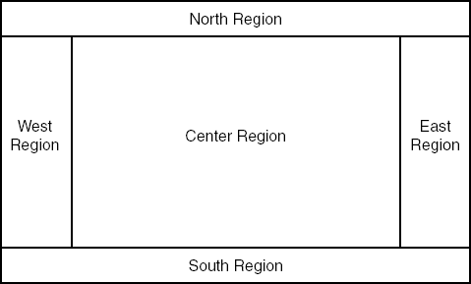
BorderLayout Manager
BorderLayout manages five regions where components can be placed.

Slide 62
BorderLayout Manager
See example: BorderWindow.java
A component placed into a container that is managed by a BorderLayout must be placed into one of five regions:
  BorderLayout.NORTH
  BorderLayout.SOUTH
  BorderLayout.EAST
  BorderLayout.WEST
  BorderLayout.CENTER

Slide 63
BorderLayout Manager
Each region can hold only one component at a time.
When a component is added to a region, it is stretched so it fills up the entire region.
BorderLayout is the default manager for JFrame objects.
  add(button, BorderLayout.NORTH);
If you do not pass a second argument to the add method, the component will be added to the center region.

Slide 64
BorderLayout Manager
Normally the size of a button is just large enough to accommodate the text that it displays
The buttons displayed in BorderLayout region will not retain their normal size.
The components are stretched to fill all of the space in their regions.

Slide 65
BorderLayout Manager
If the user resizes the window, the sizes of the components will be changed as well.
BorderLayout manager resizes components:
  placed in the north or south regions may be resized horizontally so it fills up the entire region,
  placed in the east or west regions may be resized vertically so it fills up the entire region.
  A component that is placed in the center region may be resized both horizontally and vertically so it fills up the entire region.

Slide 66
BorderLayout Manager
By default there is no gap between the regions.
An overloaded BorderLayout constructor allows horizontal and vertical gaps to be specified (in pixels).
The constructor has the following format:
BorderLayout(int horizontalGap, int verticalGap)
Example:
setLayout(new BorderLayout(5,10));

Slide 67
Nesting Components in a Layout
Adding components to panels and then nesting the panels inside the regions can overcome the single component limitation of layout regions.
By adding buttons to a JPanel and then adding the JPanel object to a region, sophisticated layouts can be achieved.
See example: BorderPanelWindow.java

Slide 68
GridLayout Manager
GridLayout creates a grid with rows and columns, much like a spreadsheet. A container that is managed by a GridLayout object is divided into equally sized cells.
columns
rows

Slide 69
GridLayout Manager
GridLayout manager follows some simple rules:
  Each cell can hold only one component.
  All of the cells are the size of the largest component placed within the layout.
  A component that is placed in a cell is automatically resized to fill up any extra space.
You pass the number of rows and columns as arguments to the GridLayout constructor.

Slide 70
GridLayout Manager
The general format of the constructor:
  GridLayout(int rows, int columns)
Example
setLayout(new GridLayout(2, 3));
A zero (0) can be passed for one of the arguments but not both.
  passing 0 for both arguments will cause an IllegalArgumentException to be thrown.

Slide 71
GridLayout Manager
Components are added to a GridLayout in the following order (for a 5×5 grid):
Example:
GridWindow.java
GridLayout also accepts nested components:
Example:
GridPanelWindow.java
1
2
3
4
5
6
7
8
9
10
11
12
13
14
15
16
17
18
19
20
21
22
23
24
25

Slide 72
Radio Buttons
Radio buttons allow the user to select one choice from several possible options.
The JRadioButton class is used to create radio buttons.
JRadioButton constructors:
  JRadioButton(String text)
  JRadioButton(String text, boolean selected)
Example:
  JRadioButton radio1 = new JRadioButton("Choice 1");
  or
  JRadioButton radio1 = new JRadioButton("Choice 1", true);
Button appears already selected when true

Slide 73
Button Groups
Radio buttons normally are grouped together.
In a radio button group only one of the radio buttons in the group may be selected at any time.
Clicking on a radio button selects it and automatically deselects any other radio button in the same group.
An instance of the ButtonGroup class is a used to group radio buttons

Slide 74
Button Groups
The ButtonGroup object creates the mutually exclusive relationship between the radio buttons that it contains.
  JRadioButton radio1 = new JRadioButton("Choice 1",true);
  JRadioButton radio2 = new JRadioButton("Choice 2");
  JRadioButton radio3 = new JRadioButton("Choice 3");
  ButtonGroup group = new ButtonGroup();
  group.add(radio1);
  group.add(radio2);
  group.add(radio3);

Slide 75
Button Groups
ButtonGroup objects are not containers like JPanel objects, or content frames.
If you wish to add the radio buttons to a panel or a content frame, you must add them individually.
  panel.add(radio1);
  panel.add(radio2);
  panel.add(radio3);

Slide 76
Radio Button Events
JRadioButton objects generate an action event when they are clicked.
To respond to an action event, you must write an action listener class, just like a JButton event handler.
See example: MetricConverter.java

Slide 77
Determining Selected Radio Buttons
The JRadioButton class’s isSelected method returns a boolean value indicating if the radio button is selected.
  if (radio.isSelected())
  {
  // Code here executes if the radio
  // button is selected.
  }

Slide 78
Selecting a Radio Button in Code
It is also possible to select a radio button in code with the JRadioButton class’s doClick method.
When the method is called, the radio button is selected just as if the user had clicked on it.
As a result, an action event is generated.
    radio.doClick();

Slide 79
Check Boxes
A check box appears as a small box with a label appearing next to it.
Like radio buttons, check boxes may be selected or deselected at run time.
When a check box is selected, a small check mark appears inside the box.
Check boxes are often displayed in groups but they are not usually grouped in a ButtonGroup.

Slide 80
Check Boxes
The user is allowed to select any or all of the check boxes that are displayed in a group.
The JCheckBox class is used to create check boxes.
Two JCheckBox constructors:
  JCheckBox(String text)
  JCheckBox(String text, boolean selected)
Example:
  JCheckBox check1 = new JCheckBox("Macaroni");
  or
  JCheckBox check1 = new JCheckBox("Macaroni",true);
Check appears in box if true

Slide 81
Check Box Events
When a JCheckBox object is selected or deselected, it generates an item event.
Handling item events is similar to handling action events.
Write an item listener class, which must meet the following requirements:
  It must implement the ItemListener interface.
  It must have a method named itemStateChanged.
  This method must take an argument of the ItemEvent type.

Slide 82
Check Box Events
Create an object of the class
Register the item listener object with the JCheckBox component.
On an event, the itemStateChanged method of the item listener object is automatically run
  The event object is passed in as an argument.

Slide 83
Determining Selected Check Boxes
The isSelected method will determine whether a JCheckBox component is selected.
The method returns a boolean value.
  if (checkBox.isSelected())
  {
  // Code here executes if the check
  // box is selected.
  }
See example: ColorCheckBoxWindow.java

Slide 84
Selecting Check Boxes in Code
It is possible to select check boxes in code with the JCheckBox class’s doClick method.
When the method is called, the check box is selected just as if the user had clicked on it.
As a result, an item event is generated.
  checkBox.doClick();

Slide 85
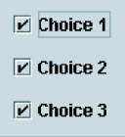
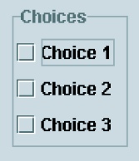
Borders
Windows have a more organized look if related components are grouped inside borders.
You can add a border to any component that is derived from the JComponent class.
  Any component derived from JComponent inherits a method named setBorder

Slide 86
Borders
The setBorder method is used to add a border to the component.
The setBorder method accepts a Border object as its argument.
A Border object contains detailed information describing the appearance of a border.
The BorderFactory class, which is part of the javax.swing package, has static methods that return various types of borders.

Slide 87
Border | BorderFactory Method | Description
Compound border | createCompoundBorder | A border that has two parts: an inside edge and an outside edge. The inside and outside edges can be any of the other borders.
Empty border | createEmptyBorder | A border that contains only empty space.
Etched border | createEtchedBorder | A border with a 3D appearance that looks “etched” into the background.
Line border | createLineBorder | A border that appears as a line.
Lowered bevel border | createLoweredBevelBorder | A border that looks like beveled edges. It has a 3D appearance that gives the illusion of being sunken into the surrounding background.
Matte border | createMatteBorder | A line border that can have edges of different thicknesses.
Raised bevel border | createRaisedBevelBorder | A border that looks like beveled edges. It has a 3D appearance that gives the illusion of being raised above the surrounding background.
Titled border | createTitledBorder | An etched border with a title.

Slide 88
The Brandi’s Bagel House Application
A complex application that uses numerous components can be constructed from several specialized panel components, each containing other components and related code such as event listeners.
Examples:
GreetingPanel.java, BagelPanel.java, ToppingPanel.java, CoffeePanel.java, OrderCalculatorGUI.java, Bagel.java

Slide 89
Splash Screens
A splash screen is a graphic image that is displayed while an application loads into memory and starts up.
A splash screen keeps the user's attention while a large application loads and executes.
Beginning with Java 6, you can display splash screens with your Java applications.

Slide 90
Splash Screens
To display the splash screen you use the java command in the following way when you run the application:
java -splash:GraphicFileName ClassFileName
GraphicFileName is the name of the file that contains the graphic image, and ClassFileName is the name of the .class fi le that you are running.
The graphic file can be in the GIF, PNG, or JPEG formats.

Slide 91
Using Console Output to Debug a GUI
Display variable values, etc. as your application executes to identify logic errors
  Use System.out.println()
    // For debugging, display the text entered, and
    // its value converted to a double.
    System.out.println("Reading " + str +
      " from the text field.");
    System.out.println("Converted value: " +
    Double.parseDouble(str));
See example: KiloConverterWindow.java

